Slide 1
Optimizing UAV Energy Consumption: Using Antenna Tilting
Jaehyun Lee
DGIST
dlwogus4066@dgist.ac.kr
31/January/2019
Winter Intern Final Presentation

Slide 2
Motivation
Fixed single antenna
UAV can only communicate small area at fixed position
UAV need to move long distance for large coverage area
Communication distance is short for coverage area
Tilting single antenna
UAV can communicate large area at fixed position
UAV move short distance for large coverage area
Communication distance is long for coverage area

Slide 3

System Model
$$θ$$

Slide 4


System Model
$$θ$$
$$θ_{tl}$$

Slide 5
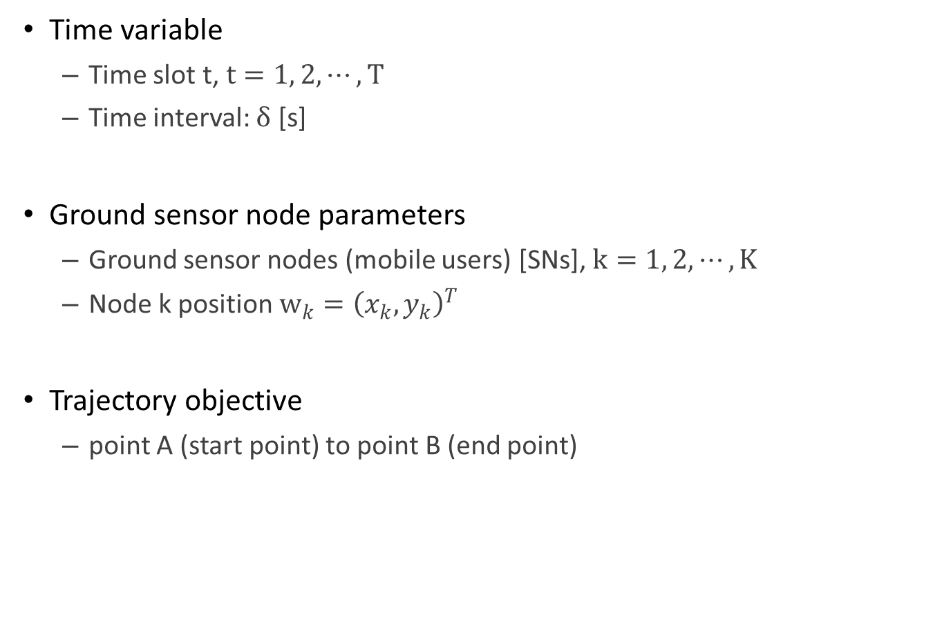
System Model
Time variable
Time slot t, $t=1, 2, ⋯, T$
Time interval: $δ$ [s]
Ground sensor node parameters
Ground sensor nodes (mobile users) [SNs], $k=1, 2, ⋯, K$
Node k position $w_{k}={\left(x_{k}, y_{k}\right)}^{T}$
Trajectory objective
point A (start point) to point B (end point)

Slide 6
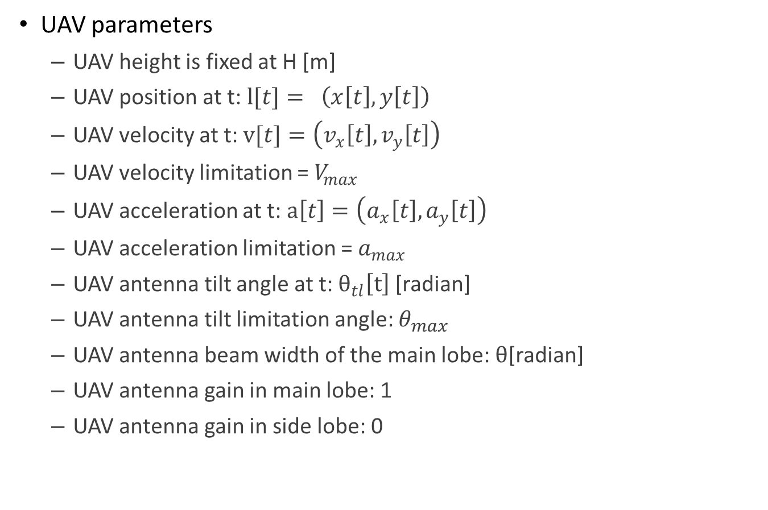
System Model
UAV parameters
UAV height is fixed at H [m]
UAV position at t: $l[t]= \left(x\left[t\right], y\left[t\right]\right)$
UAV velocity at t: $v[t]=\left(v_{x}\left[t\right], v_{y}\left[t\right]\right)$
UAV velocity limitation = $V_{max}$
UAV acceleration at t: $a\left[t\right]=\left(a_{x}\left[t\right],a_{y}\left[t\right]\right)$
UAV acceleration limitation = $a_{max}$
UAV antenna tilt angle at t: $θ_{tl}\left[t\right]$[radian]
UAV antenna tilt limitation angle: $θ_{max}$
UAV antenna beam width of the main lobe: $θ$[radian]
UAV antenna gain in main lobe: 1
UAV antenna gain in side lobe: 0

Slide 7

System Model
Channel model
Path loss model
Channel gain: $h_{k}\left[t\right]=\frac{β_{0}}{d_{k}^{2}\left[t\right]}\left(β_{0} is reference channel gain at d=1m\right)$
$d_{k}\left[t\right]\text{=}\sqrt{{\left\|l\left[t\right]−w_{k}\right\|}^{2}+H^{2}}$
$SNR=\frac{p[t]h_{k}\left[t\right]}{σ^{2}}$
Data rate at node k = $R_{k}$
$R_{k}=W_{b}×\log_{2}\left(1+\frac{p_{k}[t]γ_{0}}{d_{k}^{2}\left[t\right]}\right), γ_{0}=\frac{β_{0}}{σ^{2}}$

Slide 8
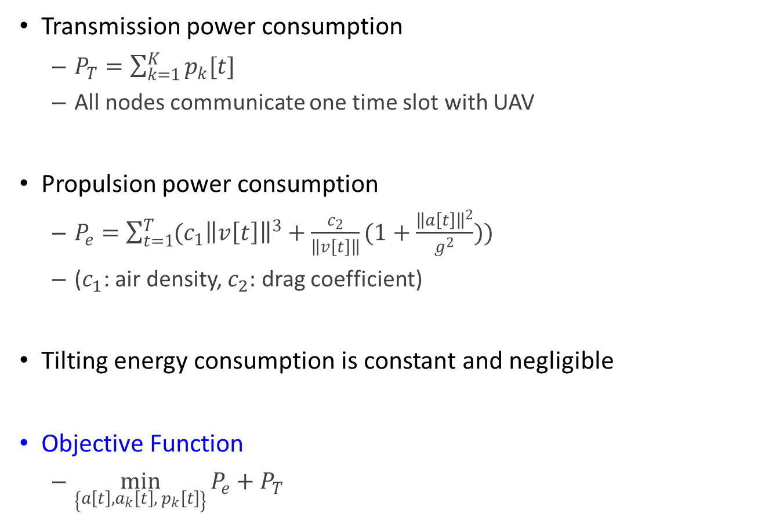
Problem Formulate
Transmission power consumption
$P_{T}=\sum_{k=1}^{K}{p_{k}[t]}$
All nodes communicate one time slot with UAV
Propulsion power consumption
$P_{e}=\sum_{t=1}^{T}{(c_{1}{\left\|v\left[t\right]\right\|}^{3}+\frac{c_{2}}{\left\|v\left[t\right]\right\|}(1+\frac{{\left\|a\left[t\right]\right\|}^{2}}{g^{2}}))}$
($c_{1}$: air density, $c_{2}:$ drag coefficient)
Tilting energy consumption is constant and negligible
Objective Function
$\min_{\left\{\begin{aligned}a\left[t\right], a_{k}\left[t\right],{ p}_{k}\left[t\right] \\ \end{aligned}\right\}}{P_{e}+P_{T}}$

Slide 9
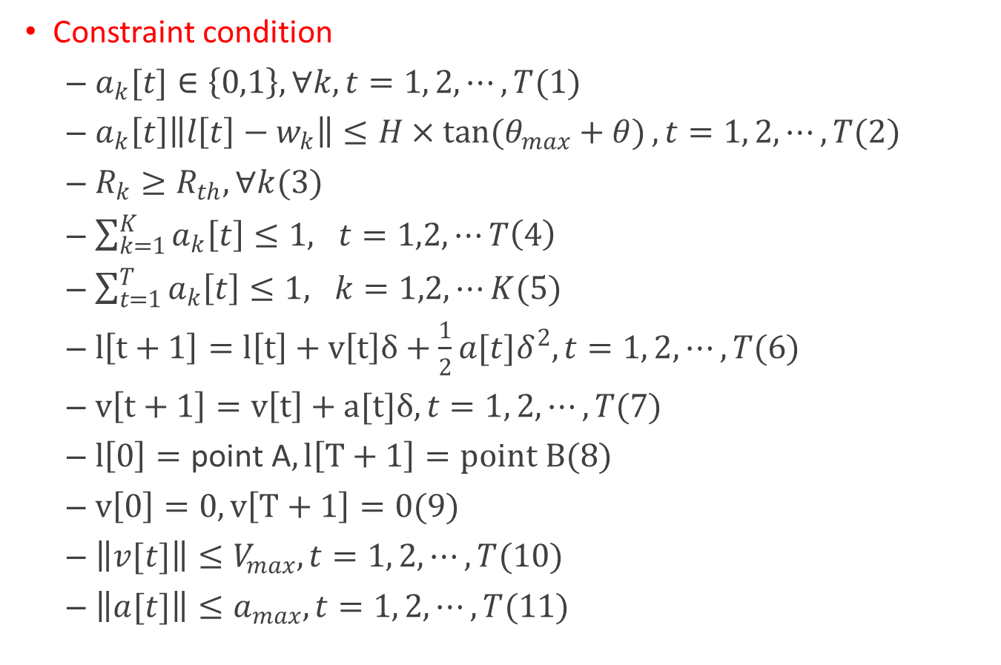
Problem Formulate
Constraint condition
$a_{k}[t]∈\left\{0,1\right\}, ∀k, t=1, 2, ⋯, T(1)$
$a_{k}\left[t\right]\left\|l\left[t\right]−w_{k}\right\|≤H×\tan{(θ_{max}+θ)}, t=1, 2, ⋯, T(2)$
$R_{k}≥R_{th}, ∀k(3)$
$\sum_{k=1}^{K}{a_{k}\left[t\right]}≤1, t=1,2,⋯T\left(4\right)$
$\sum_{t=1}^{T}{a_{k}\left[t\right]}≤1, k=1,2,⋯K(5)$
$l\left[t+1\right]=l\left[t\right]+v\left[t\right]δ+\frac{1}{2}a[t]δ^{2}, t=1, 2, ⋯, T(6)$
$v\left[t+1\right]=v\left[t\right]+a[t]δ, t=1, 2, ⋯, T(7)$
$l\left[0\right]=\text{point} \text{A}, l\left[T+1\right]=point B(8)$
$v\left[0\right]=0, v\left[T+1\right]=0(9)$
$\left\|v[t]\right\|≤V_{max}, t=1, 2, ⋯, T(10)$
$\left\|a[t]\right\|≤a_{max}, t=1, 2, ⋯, T(11)$

Slide 10
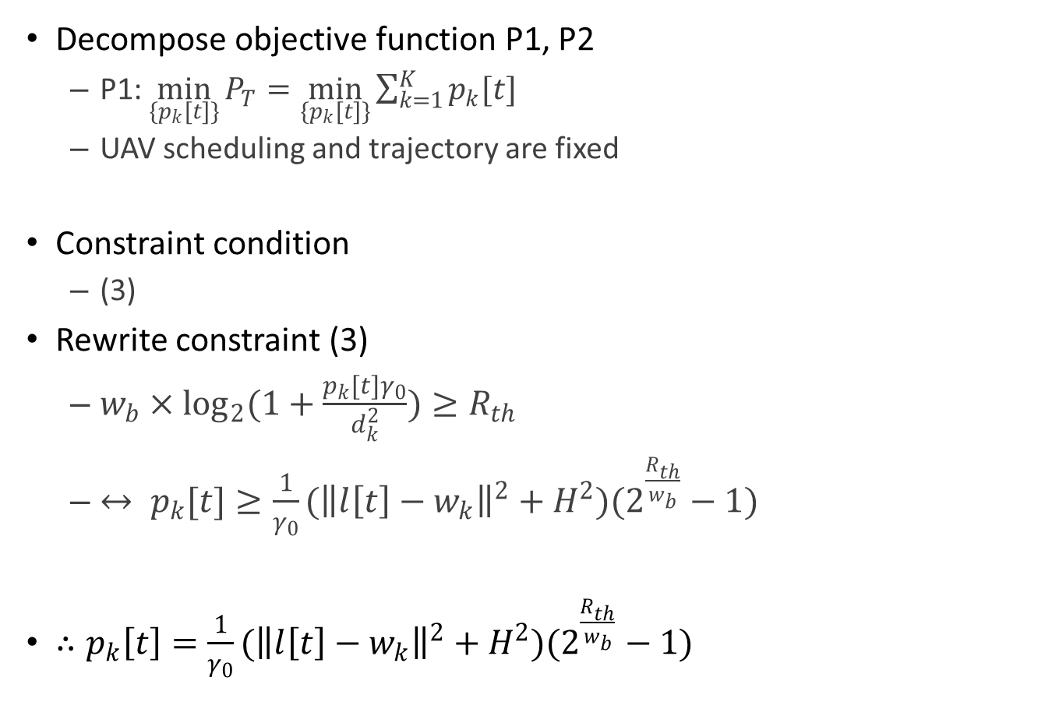
Convex Optimization
Decompose objective function P1, P2
P1: $\min_{\{p_{k}[t]\}}{P_{T}}=\min_{\{p_{k}[t]\}}{\sum_{k=1}^{K}{p_{k}[t]}}$
UAV scheduling and trajectory are fixed
Constraint condition
(3)
Rewrite constraint (3)
$w_{b}×\log_{2}{(1+\frac{p_{k}[t]γ_{0}}{d_{k}^{2}})}≥R_{th}$
$↔ p_{k}[t]≥\frac{1}{γ_{0}}({\left\|l\left[t\right]−w_{k}\right\|}^{2}+H^{2})(2^{\frac{R_{th}}{w_{b}}}−1)$
$∴p_{k}\left[t\right]=\frac{1}{γ_{0}}({\left\|l\left[t\right]−w_{k}\right\|}^{2}+H^{2})(2^{\frac{R_{th}}{w_{b}}}−1)$

Slide 11

Convex Optimization
P2
$\min_{\left\{\begin{aligned}a\left[t\right], a_{k}\left[t\right] \\ \end{aligned}\right\}}{P_{e}}=\min_{\left\{\begin{aligned}a\left[t\right], a_{k}\left[t\right] \\ \end{aligned}\right\}}{\sum_{t=1}^{T}{(c_{1}{\left\|v\left[t\right]\right\|}^{3}+\frac{c_{2}}{\left\|v\left[t\right]\right\|}(1+\frac{{\left\|a[t]\right\|}^{2}}{g^{2}}))}}$
Constraint condition
$\left(1\right), \left(2\right), \left(4\right), \left(5\right), \left(6\right),\left(7\right), \left(8\right), \left(9\right), \left(10\right), (11)$
P2 is non-convex problem. Thus, optimizing by simulation.

Slide 12
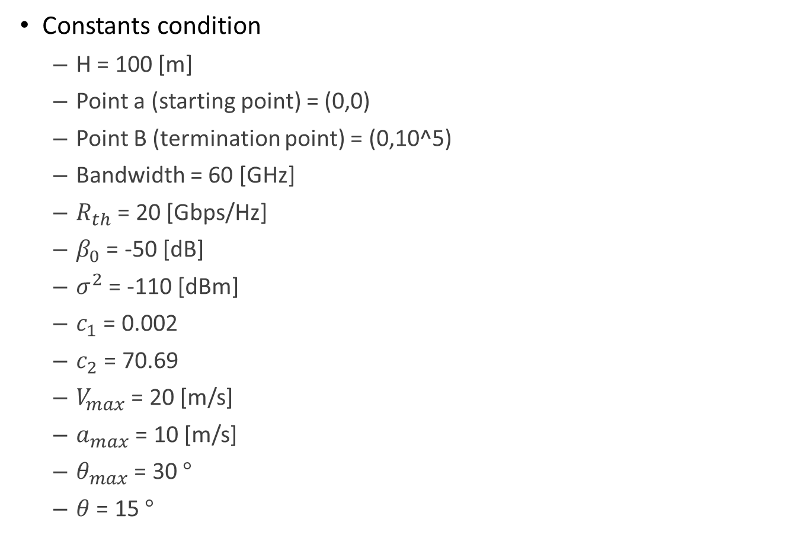
Simulation Setup
Constants condition
H = 100 [m]
Point a (starting point) = (0,0)
Point B (termination point) = (0,10^5)
Bandwidth = 60 [GHz]
$R_{th}$ = 20 [Gbps/Hz]
$β_{0}$ = -50 [dB]
$σ^{2}$ = -110 [dBm]
$c_{1}$ = 0.002
$c_{2}$ = 70.69
$V_{max}$ = 20 [m/s]
$a_{max}$ = 10 [m/s]
$θ_{max}$ = 30 $°$
$θ$ = 15 $°$

Slide 13
Simulation Setup
Constraint condition
Start velocity = 0 [m/s], Final velocity = 0 [m/s]
UAV has infinite power
UAV is hovering when communicate with node k
UAV communicate with one node k at one time
Nodes amount = 2k
Nodes location is randomness point
UAV communicates with node k at the maximum communication possible distance
Downlink scenario UAV to node(mobile user)

Slide 14
Simulation Setup
Propulsion power consumption of UAV acceleration interval is ignored because of negligible and improper integral
Because of randomness, simulation repeat 1000 and average it
Plotting result – average to improve visibility of the graph
UAV follow trajectory algorithm(next page)
First simulation variable set: tilting angle, communication time
Second simulation variable set: tilting angle, nodes amount

Slide 15



Simulation Trajectory Algorithm
$$y$$
Point B
(0,10^5)
Node 3
Node 4
Node 2
Node 5
Node 6
Node 1
Point A
(0,0)
$$x$$
$$0$$

Slide 16






Simulation Nodes Location
$$y$$
$$(0,10^5)$$
Randomness
k
Randomness
k
$$x$$
$$(−10^5,0)$$
$$(−100,0)$$
$$0$$
$$(100,0)$$
$$(10^5,0)$$

Slide 17
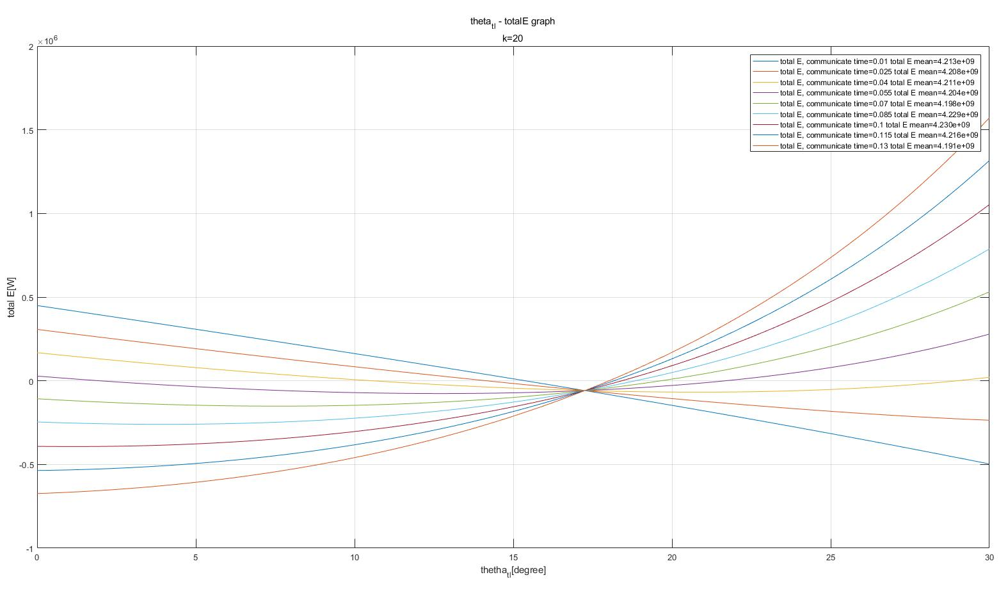
Simulation Result of Communication time
Tilting angle – Total energy graph
x-axis: tilting angle[degree]
y-axis: Total Energy [J]

Slide 18
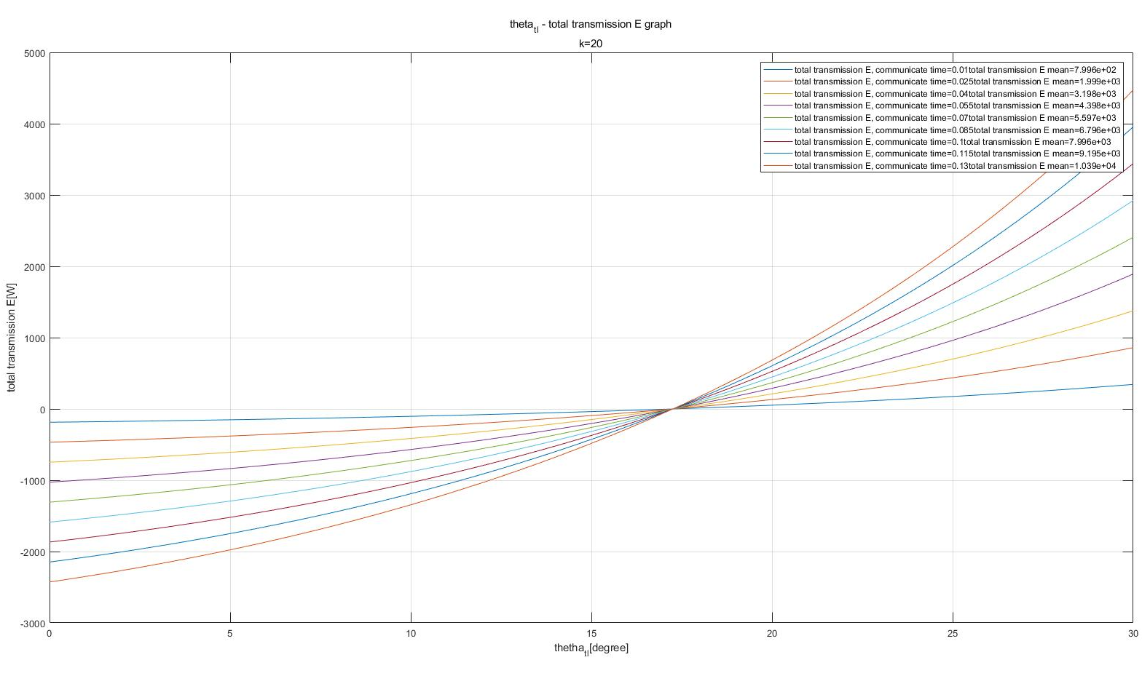
Simulation Result of Communication time
Tilting angle – Total transmission energy graph
x-axis: tilting angle[degree]
y-axis: Total transmission Energy [J]

Slide 19
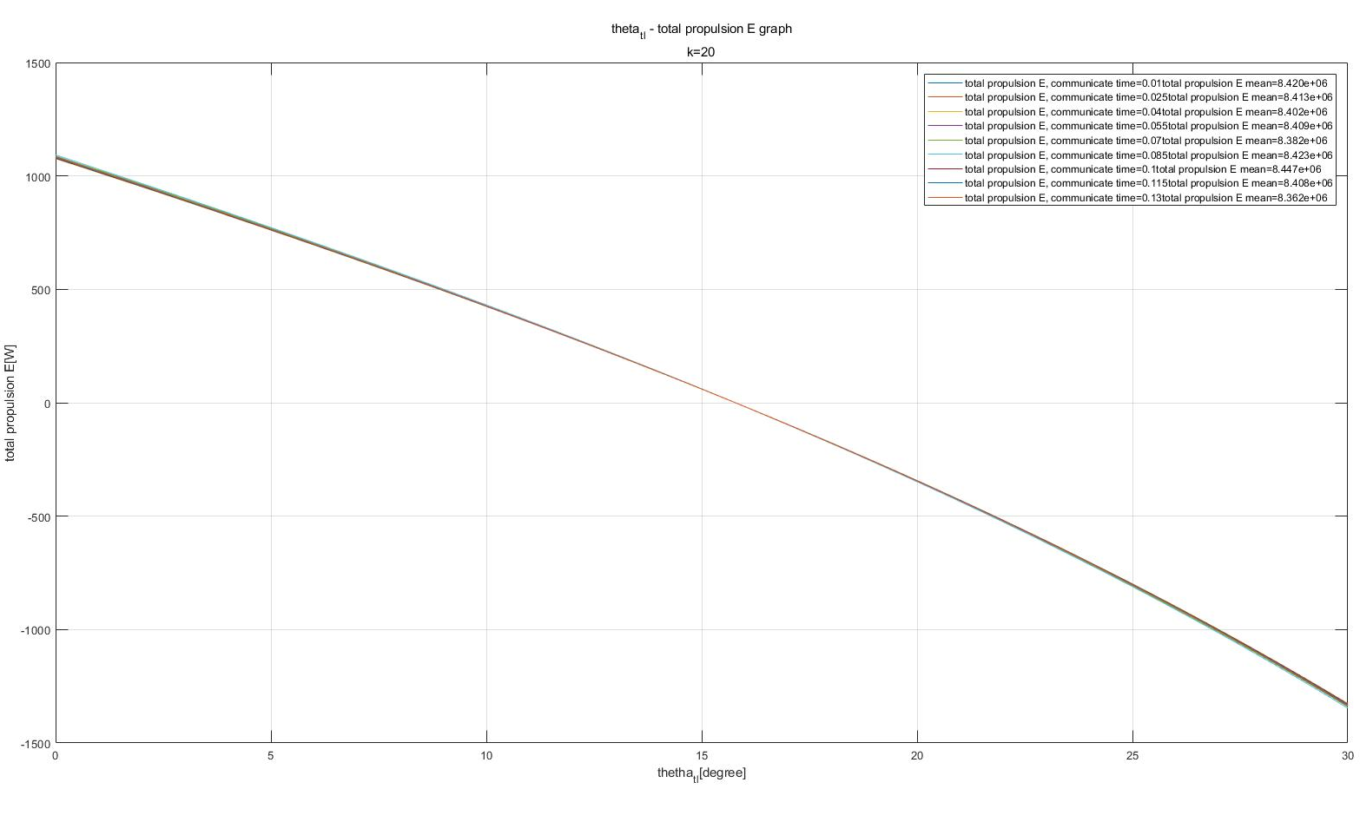
Simulation Result of Communication time
Tilting angle – Total propulsion energy graph
x-axis: tilting angle[degree]
y-axis: Total propulsion energy [J]

Slide 20
Simulation Result of Communication time
Communication time | Optimal tilting angle [degree]
0.01 | 30.00
0.025 | 30.00
0.04 | 20.81
0.055 | 12.70
0.07 | 7.60
0.085 | 3.96
0.1 | 1.14
0.115 | 0
0.13 | 0

Slide 21
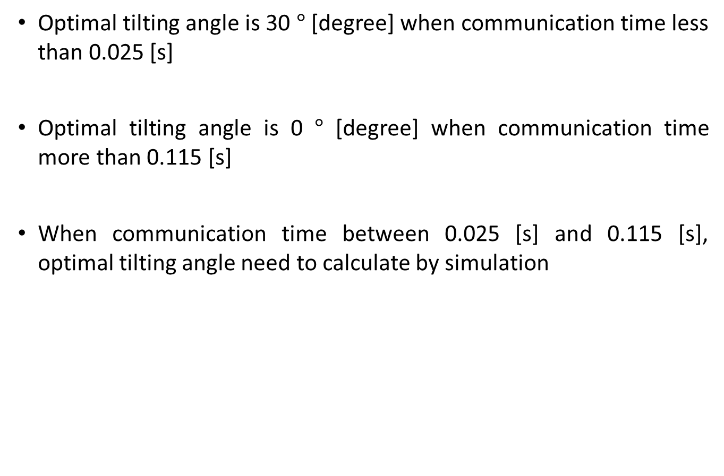
Simulation Result Analysis of Communication time
Optimal tilting angle is 30 $°$ [degree] when communication time less than 0.025 [s]
Optimal tilting angle is 0 $°$ [degree] when communication time more than 0.115 [s]
When communication time between 0.025 [s] and 0.115 [s], optimal tilting angle need to calculate by simulation

Slide 22
Simulation Result Analysis of Communication time
Propulsion energy is in inverse proportion to the tilting angle
Propulsion energy gradient independent of communication time
Transmission energy is in direct proportion to the tilting angle
Transmission energy gradient is in direct proportion to the communication time

Slide 23
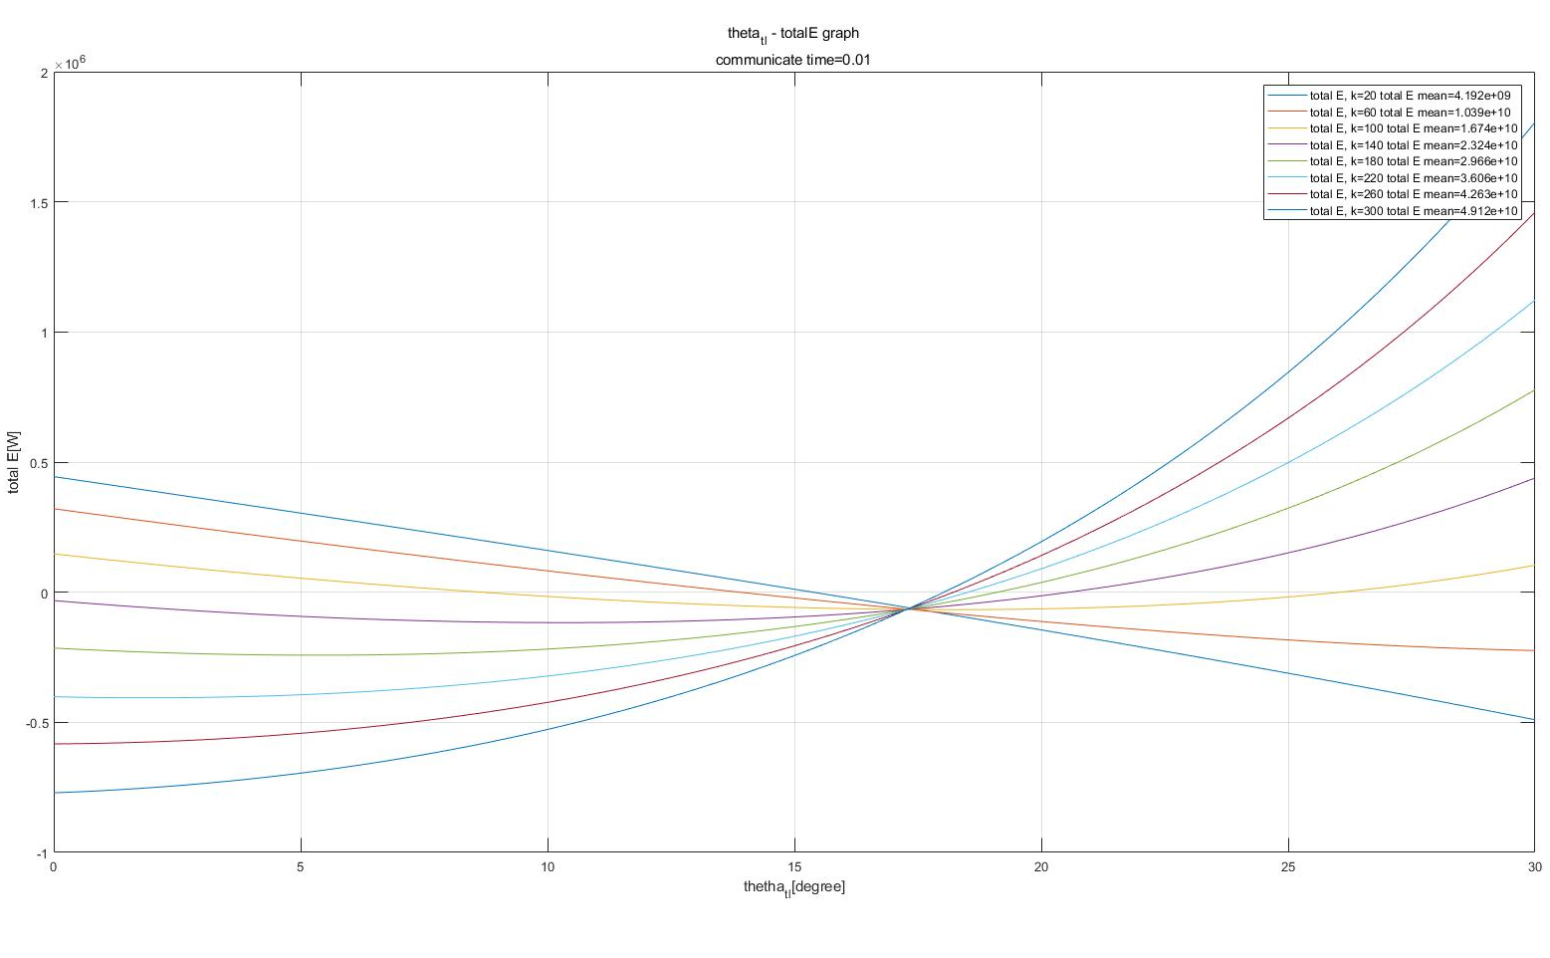
Simulation Result of Node Amount
Tilting angle – Total energy graph
x-axis: tilting angle[degree]
y-axis: Total Energy [J]

Slide 24
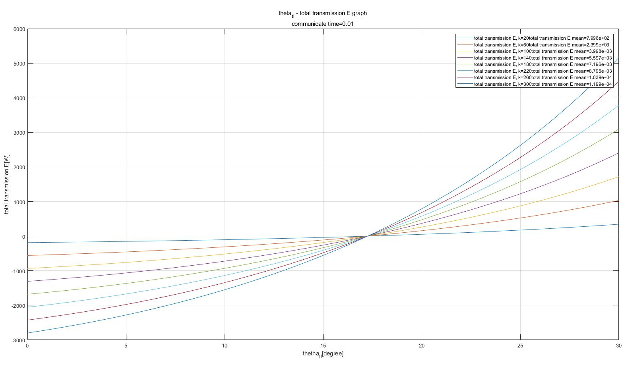
Simulation Result of Node Amount
Tilting angle – Total transmission energy graph
x-axis: tilting angle[degree]
y-axis: Total transmission Energy [J]

Slide 25
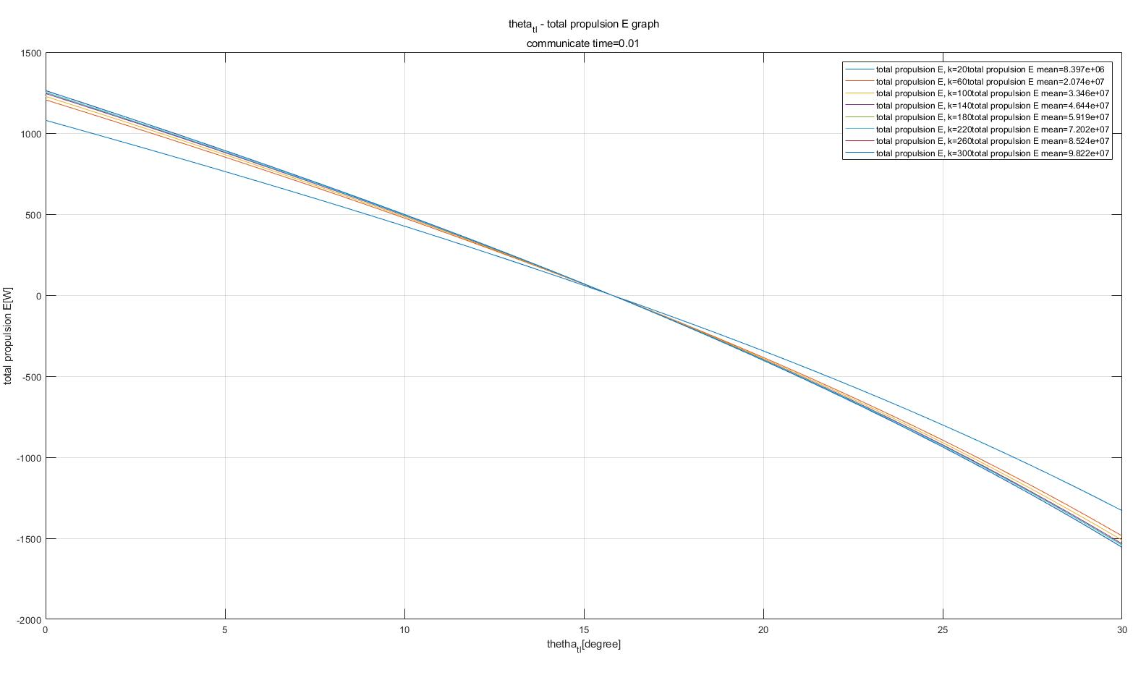
Simulation Result of Node Amount
Tilting angle – Total propulsion energy graph
x-axis: tilting angle[degree]
y-axis: Total propulsion energy [J]

Slide 26
Simulation Result of Node Amount
Node amount | Optimal tilting angle [degree]
20 | 30.00
60 | 30.00
100 | 18.20
140 | 10.33
180 | 5.35
220 | 1.89
260 | 0
300 | 0

Slide 27
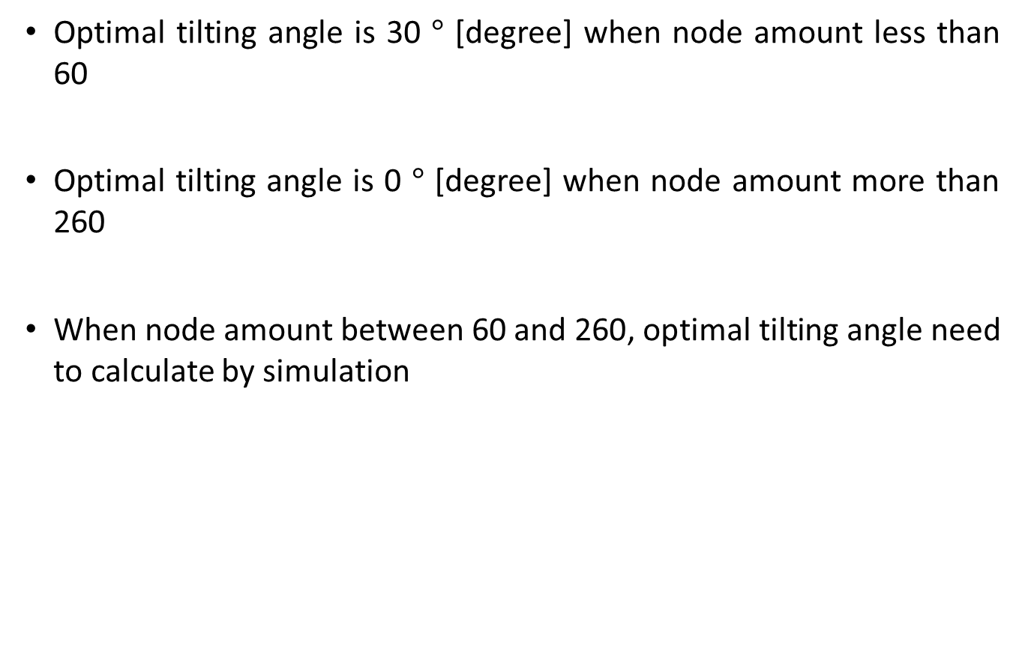
Simulation Result Analysis of Node Amount
Optimal tilting angle is 30 $°$ [degree] when node amount less than 60
Optimal tilting angle is 0 $°$ [degree] when node amount more than 260
When node amount between 60 and 260, optimal tilting angle need to calculate by simulation

Slide 28
Simulation Result Analysis of Node Amount
Propulsion energy is in inverse proportion to the tilting angle
Propulsion energy gradient is decrease when node amount increase
Transmission energy is in direct proportion to the tilting angle
Transmission energy gradient is in direct proportion to the node amount

Slide 29
Simulation weakness point
Trajectory algorithm is not the shortest distance trajectory
Increase impact of propulsion energy on total energy
Only communicate at maximum possible communicate distance
Impact on trajectory and transmission power
UAV only communicate when hovering
Impact on propulsion energy because of acceleration

Slide 30
Future Study
Simulation with the shortest distance trajectory algorithm
Trajectory optimizing problem with antenna tilting
Simulation with UAV communicate with node when UAV is moving

Slide 31
Thank you
Any Questions?
Email : dlwogus4066@dgist.ac.kr

